Slide 1
Programming Fundamentals
By
Shazmeen Batool

Slide 2
Previous Lecture
Random Numbers

Slide 3
Today’s Lecture
for loop

Slide 4
Why Loop?
Loops cause a section of your program to be repeated a certain number of times.
Repeats until the condition remains true.
Terminates when the condition becomes false.

Slide 5

Loop
Suppose that you need to display a string (e.g., "Welcome to C++!") 100 times
So how to solve this problem?

Slide 6
for loop
C++ provides a powerful construct called a loop that controls how many times an operation or a sequence of operations is performed in succession.
The for loop is ideal for performing a known number of iterations.
Sometimes you know the exact number of iterations that a loop must perform. A loop that repeats a specific number of times is known as a count-controlled loop.

Slide 7
for loop
Count-controlled loops are so common that C++ provides a type of loop specifically for them. It is known as the for loop. The for loop is specifically designed to initialize, test, and update a counter variable.
Using a loop statement, you simply tell the computer to display a string 100 times without having to code the print statement 100 times.

Slide 8
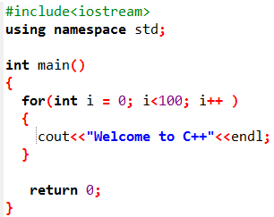
for loop
Note: The braces enclosing the loop body can be omitted only if the loop body contains one statement or none.

Slide 9
for loop
The variable i is initially 0. The loop checks whether (i < 100) is true. If so, it executes the loop body to display the message Welcome to C++! and increments i by 1. It repeatedly executes the loop body until (i < 100) becomes false (i.e., when i reaches 100). At this point, the loop terminates and the next statement after the loop statement is executed.
Loops are constructs that control repeated executions of a block of statements. The concept of looping is fundamental to programming. C++ provides three types of loop statements: for loops, while loops, and do-while loops.

Slide 10
for loop
A for loop is a repetition control structure that allows you to efficiently write a loop that needs to execute a specific number of times.
A for loop has a concise syntax for writing loops.
Typically, for statements are used for counter-controlled repetition

Slide 11

for loop
The general form of the for statement is
for (i = initialValue; i < endValue; i++)
{
// Loop body ...
}

Slide 12
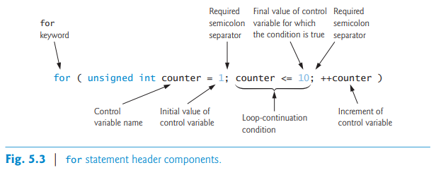
for loop
If you incorrectly wrote counter < 10 as the loop-continuation condition in Fig. 5.3, then the loop would execute only 9 times. This is a common off-by-one error.

Slide 13
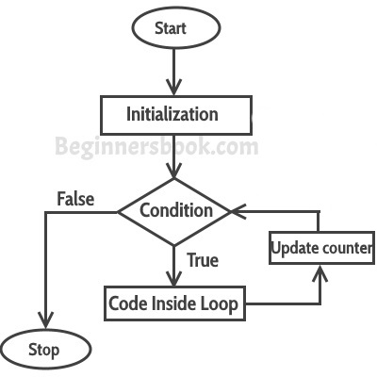
for loop

Slide 14
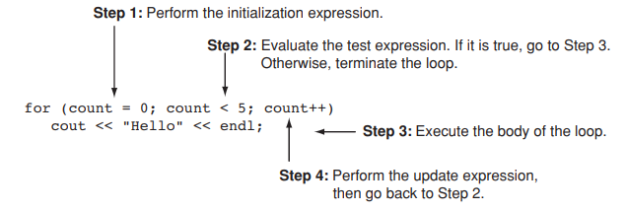
for loop

Slide 15
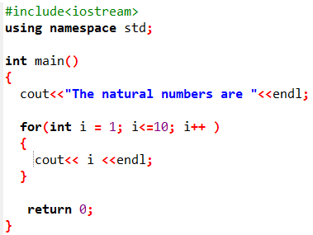
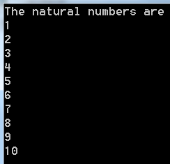
Write a C++ program to find the first 10 natural numbers.
Output:

Slide 16
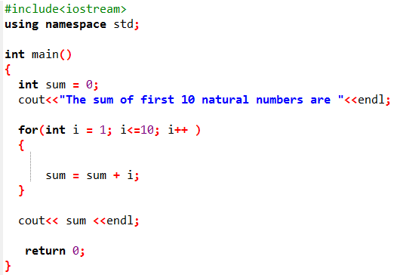

Write a C++ program to find the sum of first 10 natural numbers.
Output:

Slide 17
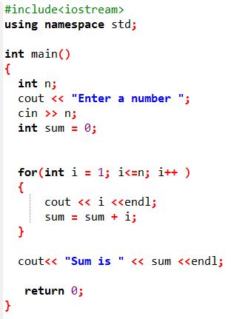
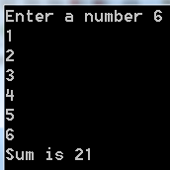
Write a C++ program to display n terms of natural number and their sum.
Output:

Slide 18
Tasks
Vary the control variable from 1 to 100 in increments of 1.
Vary the control variable from 100 down to 1 in decrements of 1.
Vary the control variable from 7 to 77 in steps of 7.

Slide 19
Tasks
Vary the control variable from 20 down to 2 in steps of -2.
Vary the control variable over the following sequence of values: 2, 5, 8, 11, 14, 17.
Vary the control variable over the following sequence of values: 99, 88, 77, 66, 55.

Slide 20
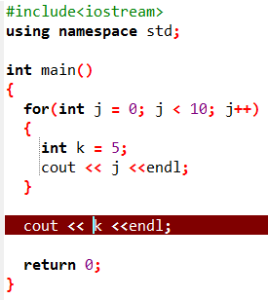
Errors
Variable Visibility

Slide 21
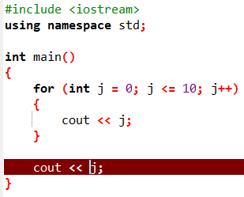
Errors
Variable Visibility

